Slide 1

Codergirl – Frontend
Unit 2 - Class 10
Jan 11, 2021
Notes:
1

Slide 2
Agenda
Section 15 – Forms – Reactive Approach
Studio – Assignment # 7 and Section 16.
Notes:
2

Slide 3
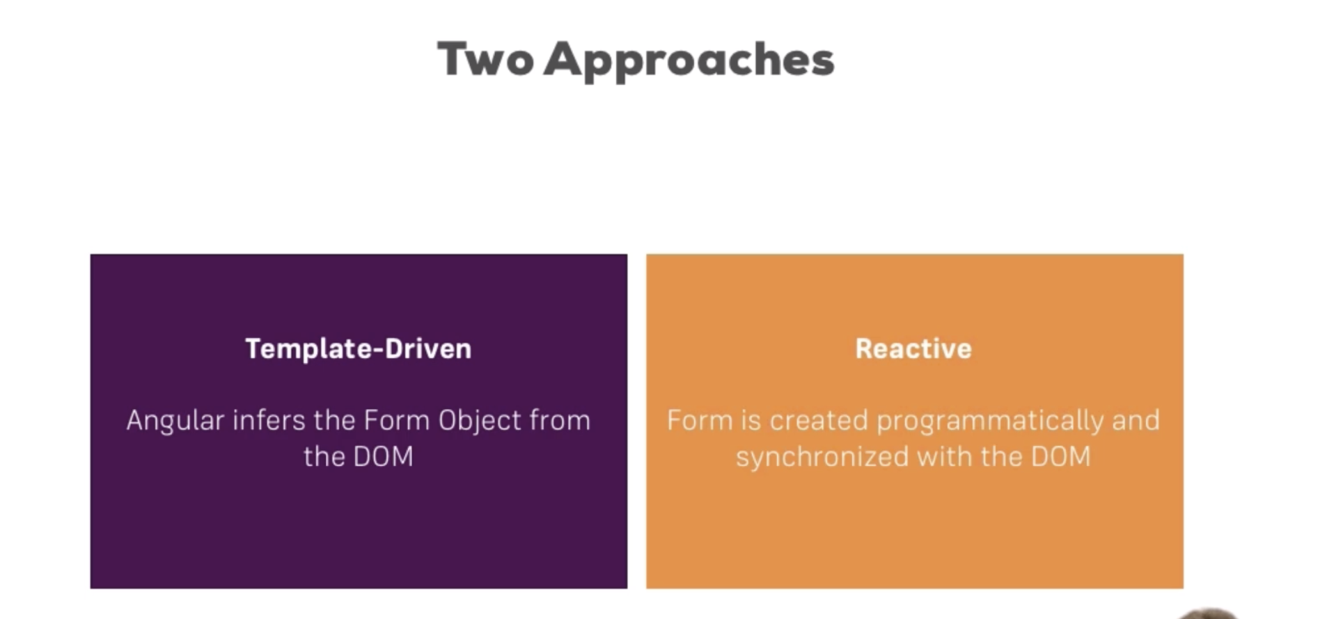
Notes:
3

Slide 4
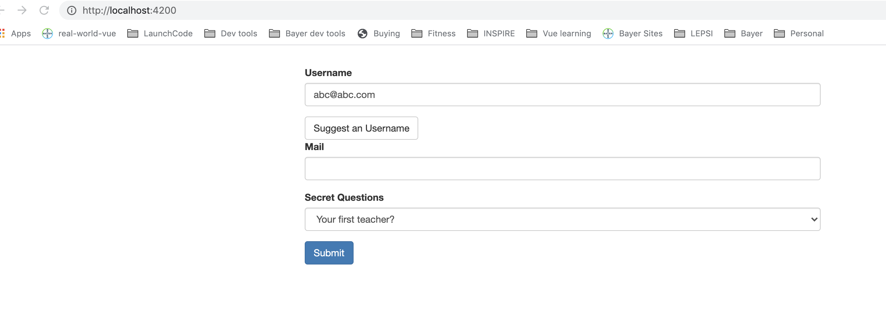
Forms
doesn’t trigger http submit Validation of form.
Notes:
4

Slide 5
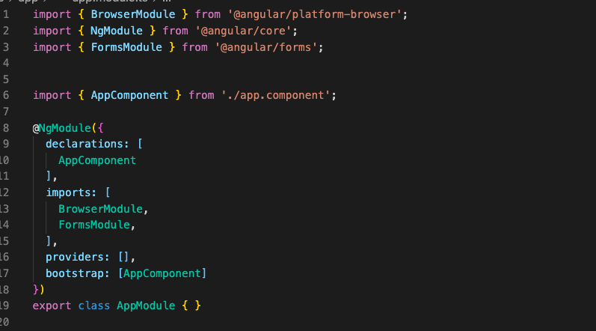
Forms
Notes:
5

Slide 6
Configure the form
Register the controls with ngModel and name.
Notes:
6

Slide 7
Submitting the form
Make the form submittable. Html JS submit event triggered and Angular provides a directive ngSubmit
Notes:
7

Slide 8
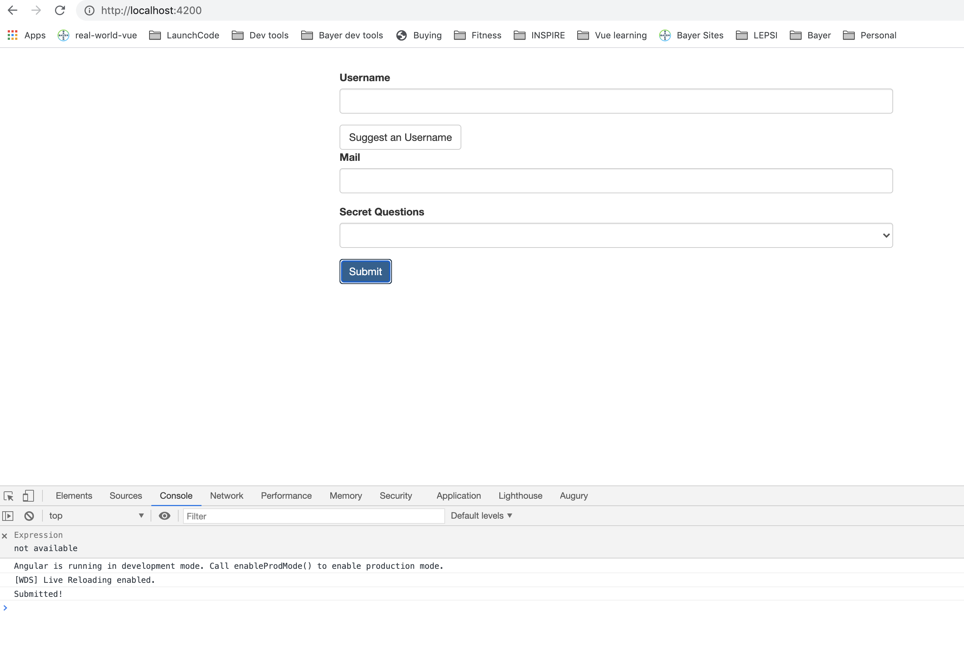
Submitting the form
Notes:
8

Slide 9
Submitting the form
Notes:
9

Slide 10
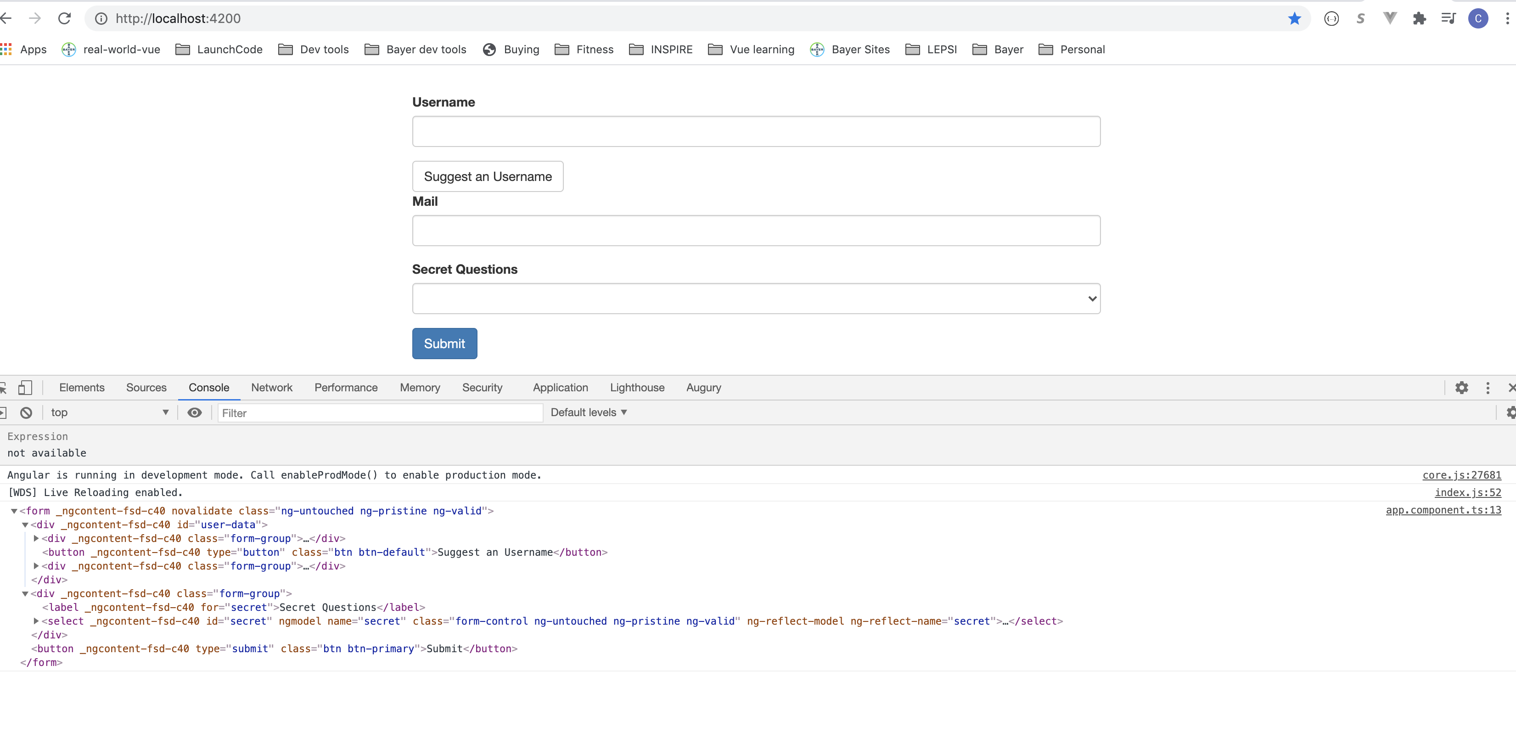
Submitting the form
Notes:
10

Slide 11
Submitting the form
Notes:
11

Slide 12
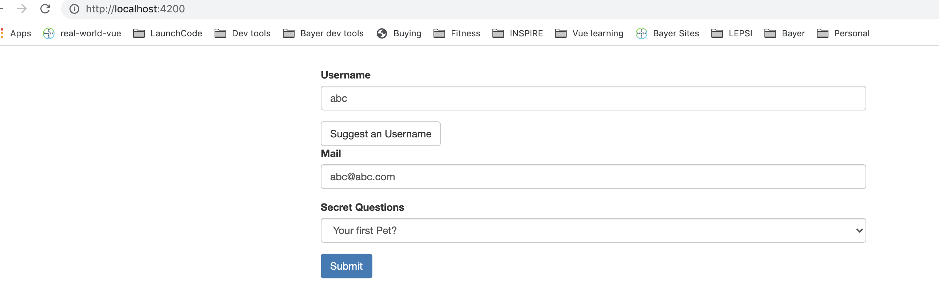
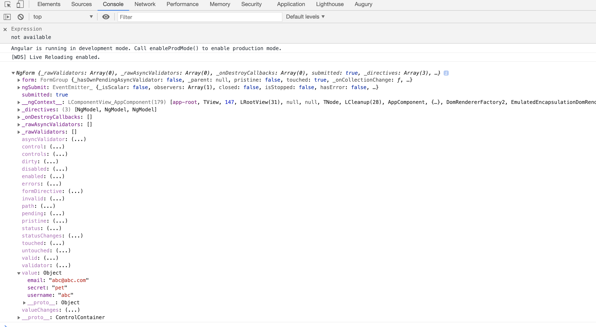
Value of the form
Notes:
12

Slide 13
Controls for form
Dirty means some value is changed in form (user typed)
Disabled if form disabled
Invalid works with form validations
Touched is true if clicked into form
Notes:
13

Slide 14
Local reference is available in Form
Notes:
14

Slide 15
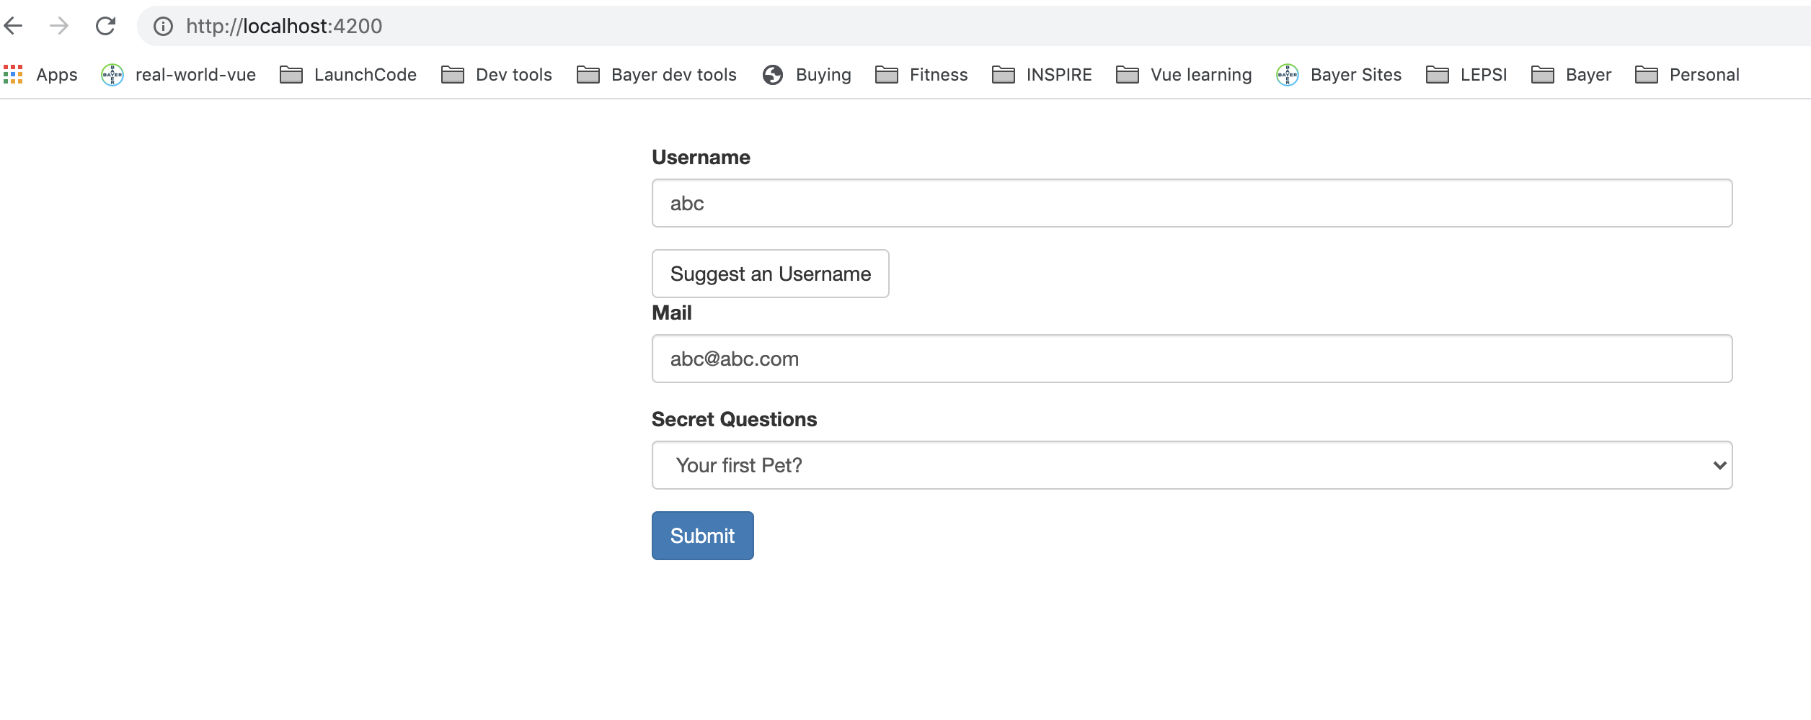
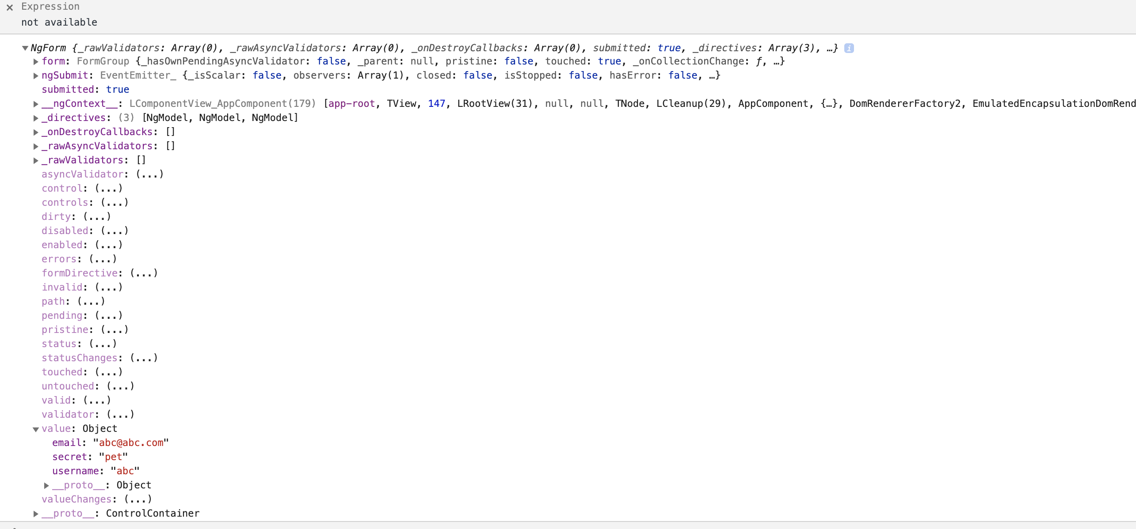
Local reference is available in Form, also can be available before form is submitted
Notes:
15

Slide 16
Form Validations
Template driven approach adds validation to template.
Built in directives
required is selector
email
Notes:
16

Slide 17
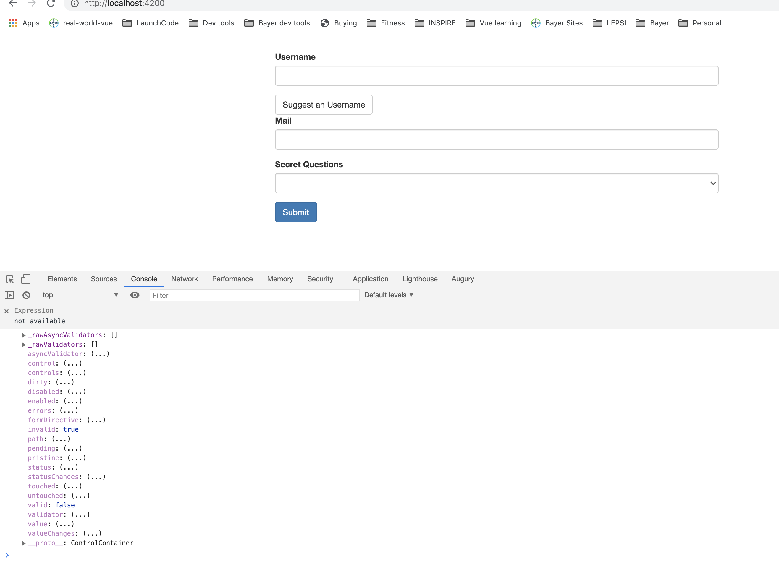
Form Validations
Notes:
17

Slide 18
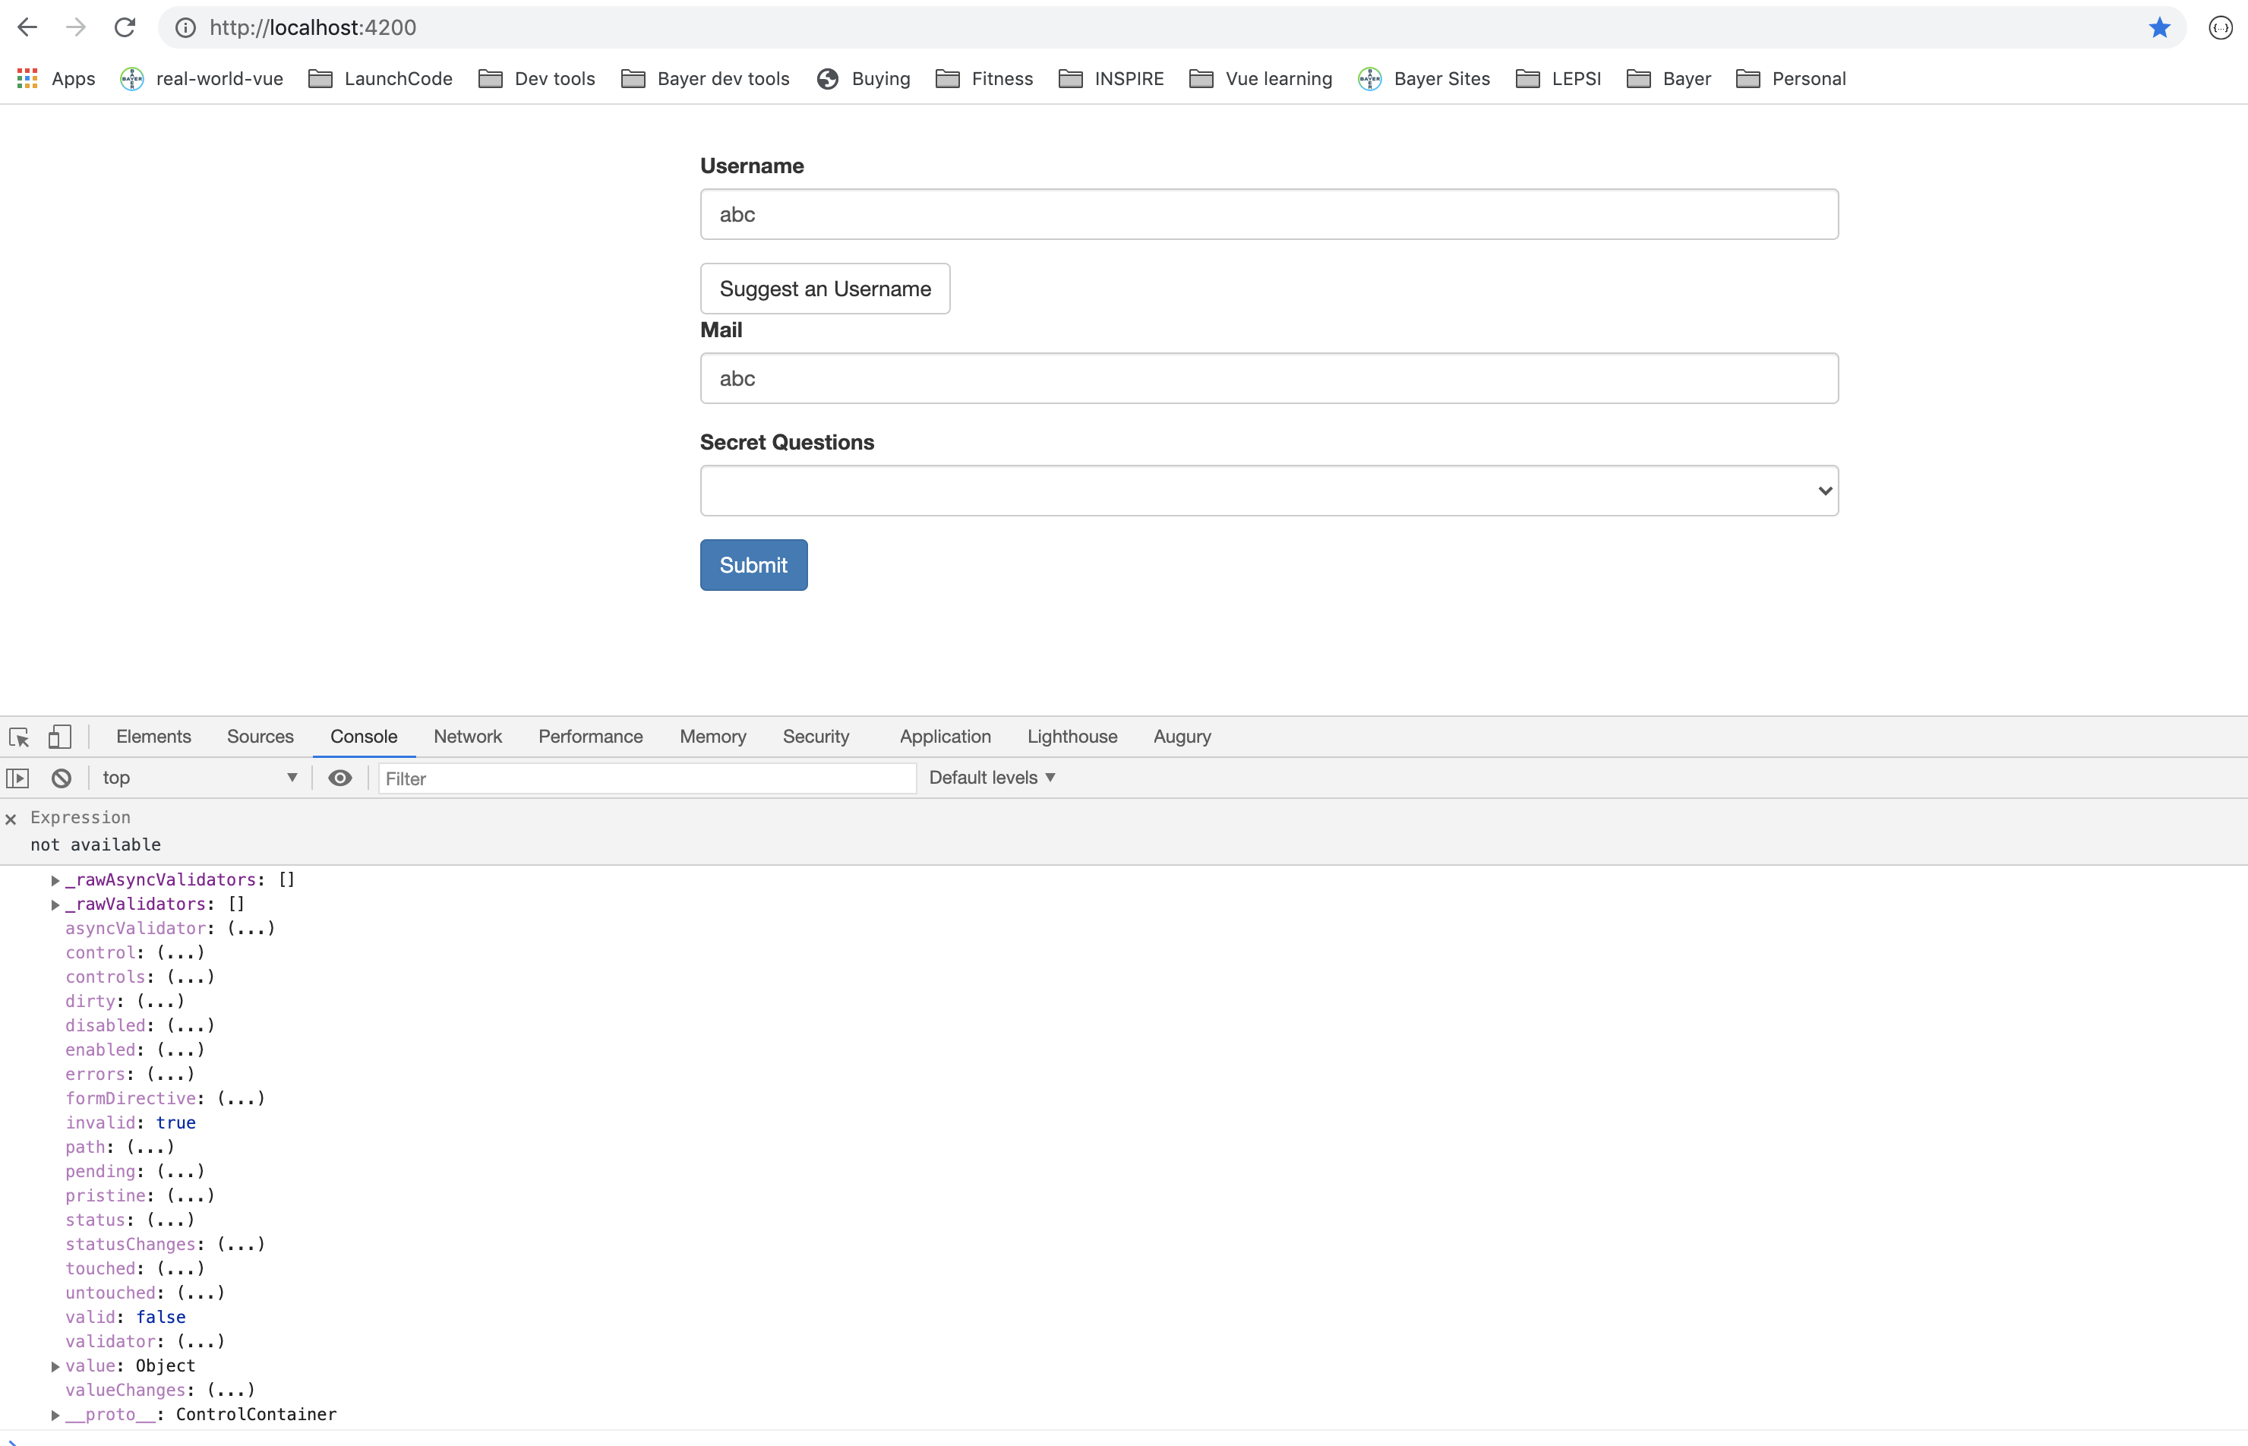
Form Validations
Notes:
18

Slide 19
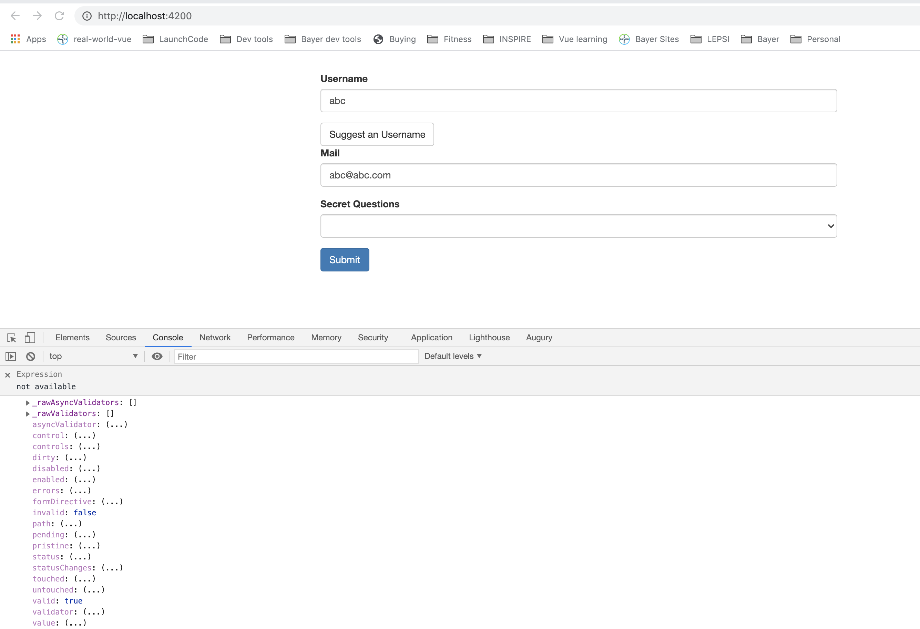
Form Validations – email form control also has valid set to true.
Notes:
19

Slide 20
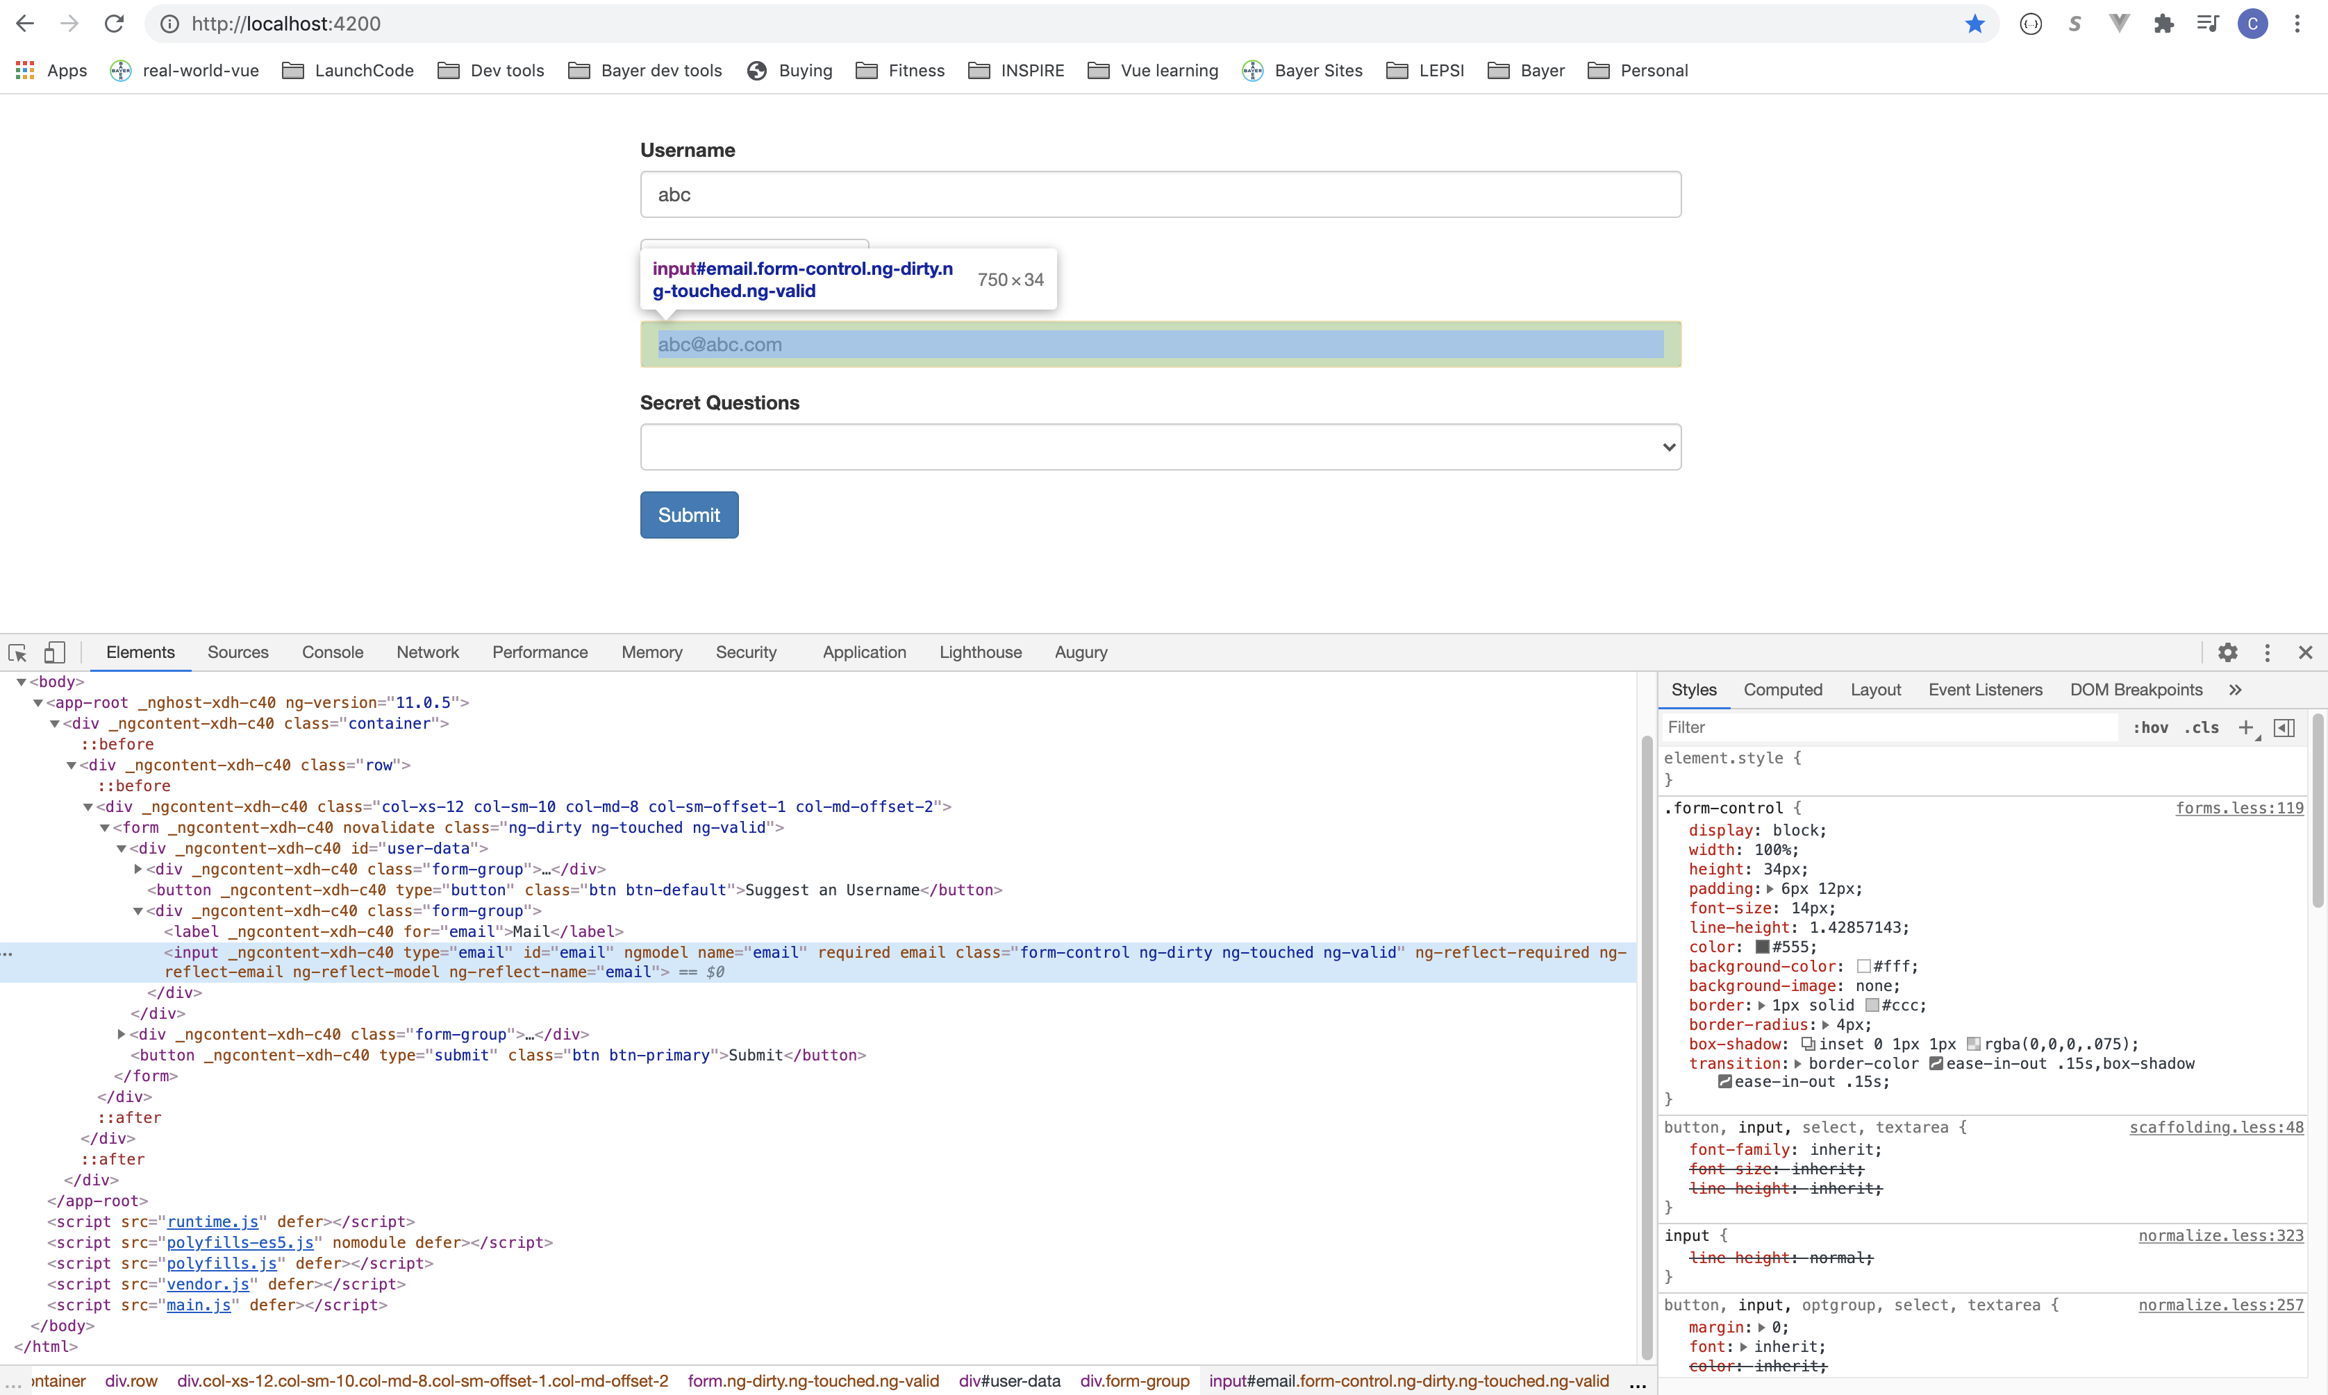
Form Validations – Angular adds some attributes to the elements.
Notes:
20

Slide 21
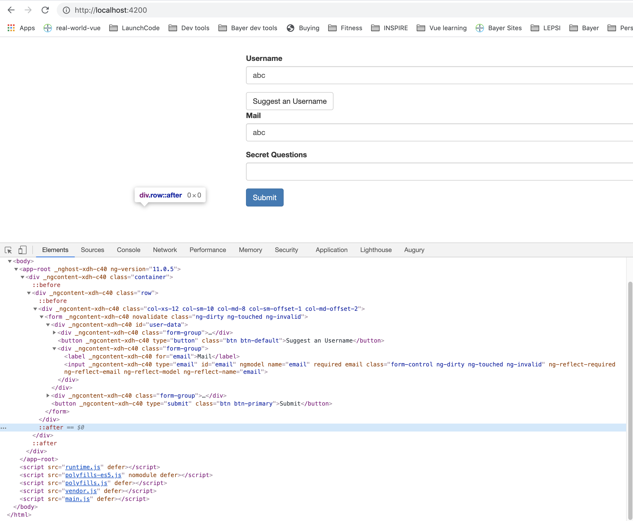
Form Validations – Angular adds some attributes to the elements.
Notes:
21

Slide 22
Change form behavior on validation result.
Disable submit button if form is invalid.
Notes:
22

Slide 23
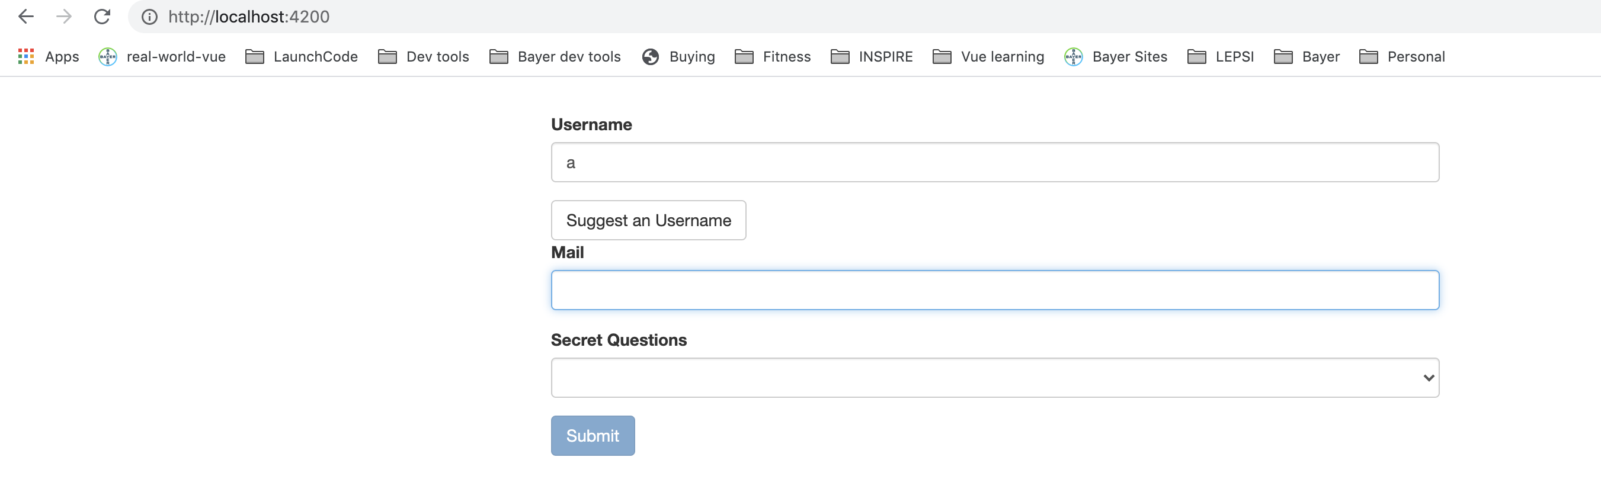
Submit disabled for invalid form.
Notes:
23

Slide 24
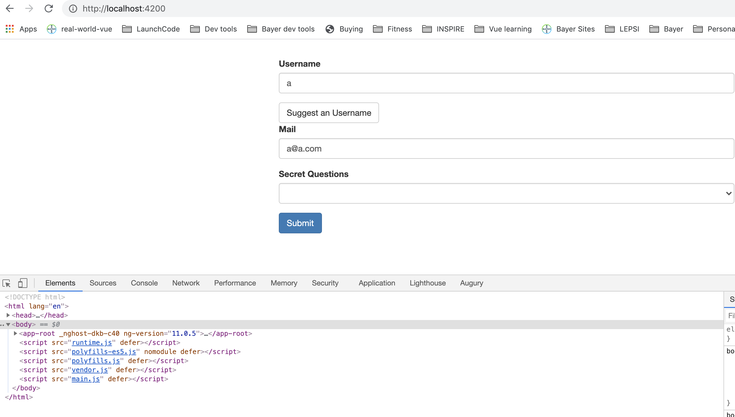
Submit not disabled for valid form.
Notes:
24

Slide 25
Change styling
The form is also invalid, so conditional styling needs to be applied just to element not entire form.
Notes:
25

Slide 26
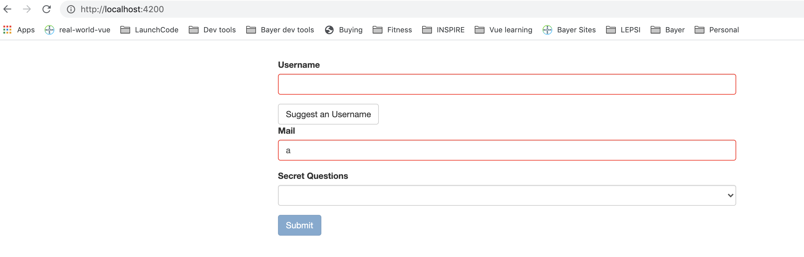
Change styling
The form is also invalid, so conditional styling needs to be applied just to element not entire form.
Notes:
26

Slide 27
Validation messages for user
Notes:
27

Slide 28
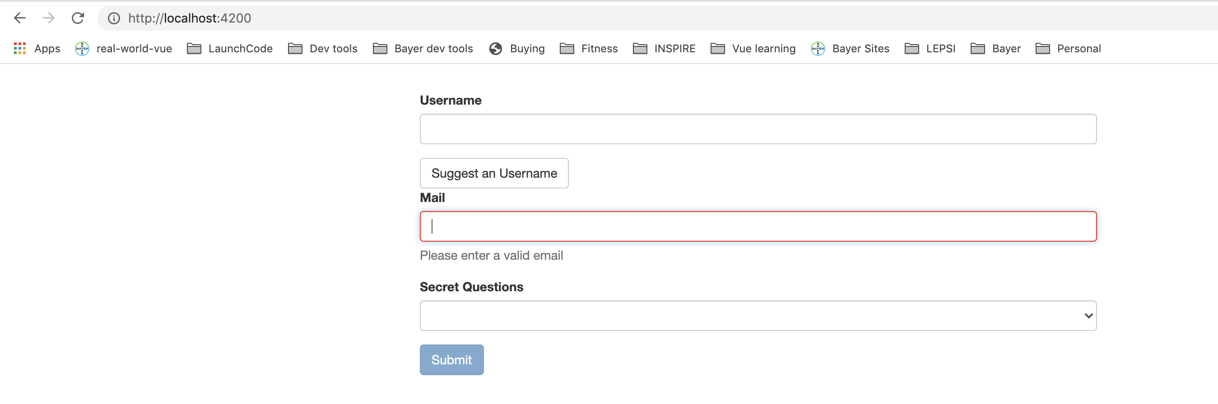
Validation messages for user
Notes:
28

Slide 29
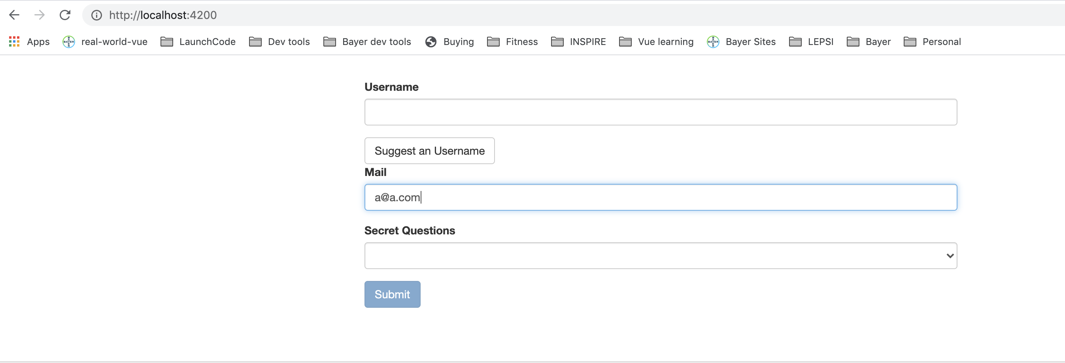
Validation messages for user
Notes:
29

Slide 30
Set Default Values for ngModel
Notes:
30

Slide 31
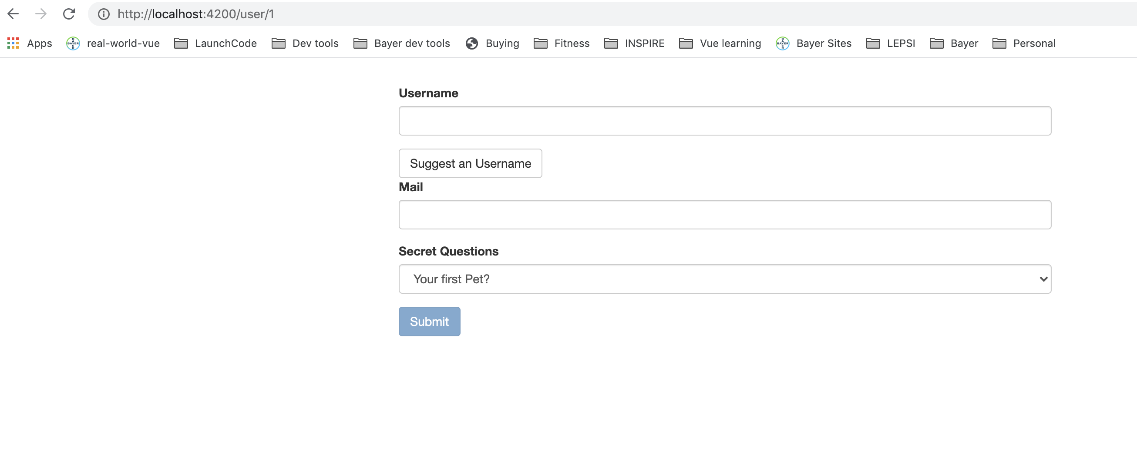
Set Default Values for ngModel
Notes:
31

Slide 32
Set Default Values for ngModel – add it to a property.
Notes:
32

Slide 33
Set Default Values for ngModel – add it to a property.
Notes:
33

Slide 34
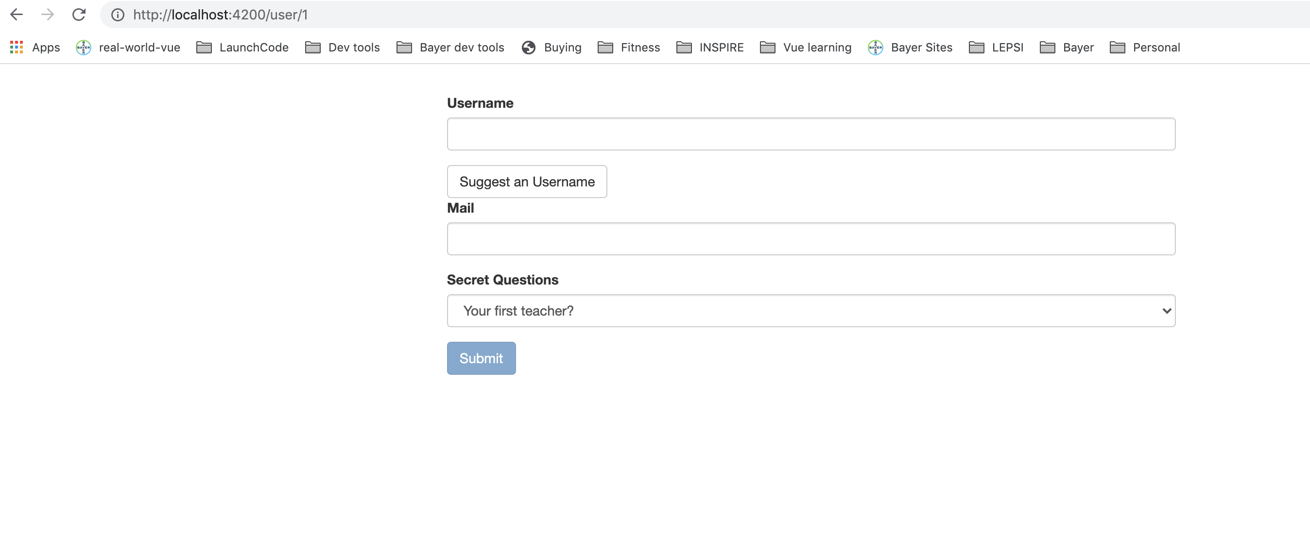
Set Default Values for ngModel – add it to a property.
Notes:
34

Slide 35
Using ngModel with two-way-binding
Notes:
35

Slide 36
Using ngModel with two-way-binding
Notes:
36

Slide 37
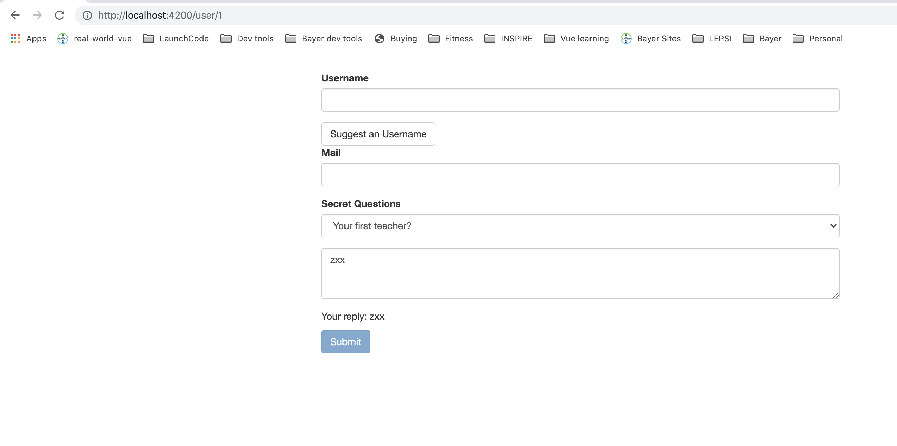
Using ngModel with two-way-binding
Notes:
37

Slide 38
Grouping form controls – structure in object.
If we use ngModelGroup and give it a string, then Angular creates a control group as well as a value group. Also get the html css to see validity etc.
Notes:
38

Slide 39
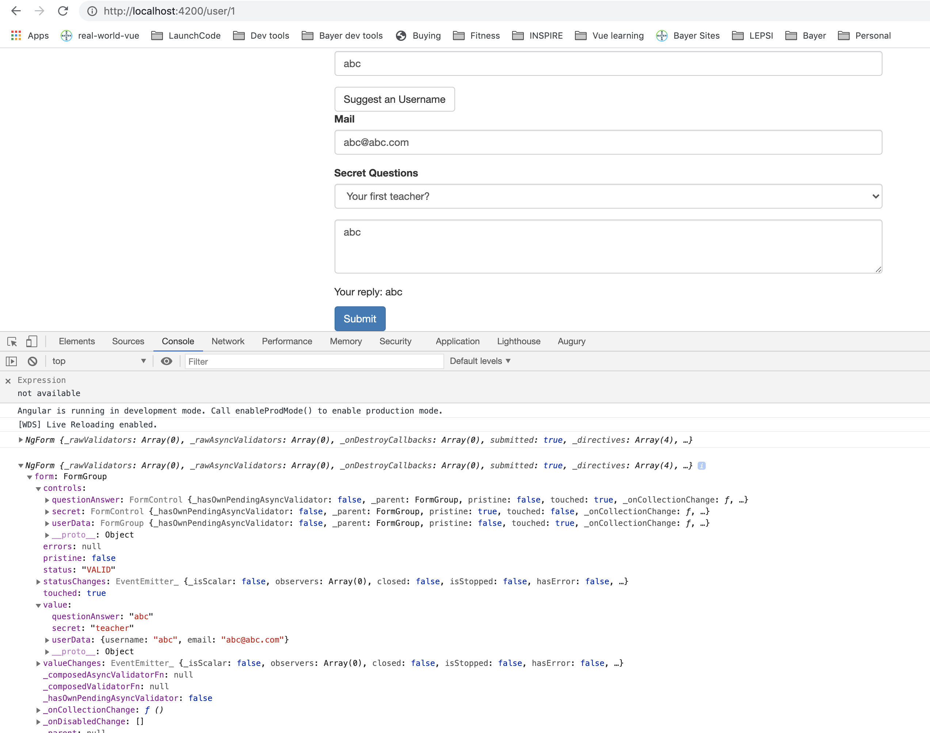
Grouping form controls – structure in object.
Notes:
39

Slide 40
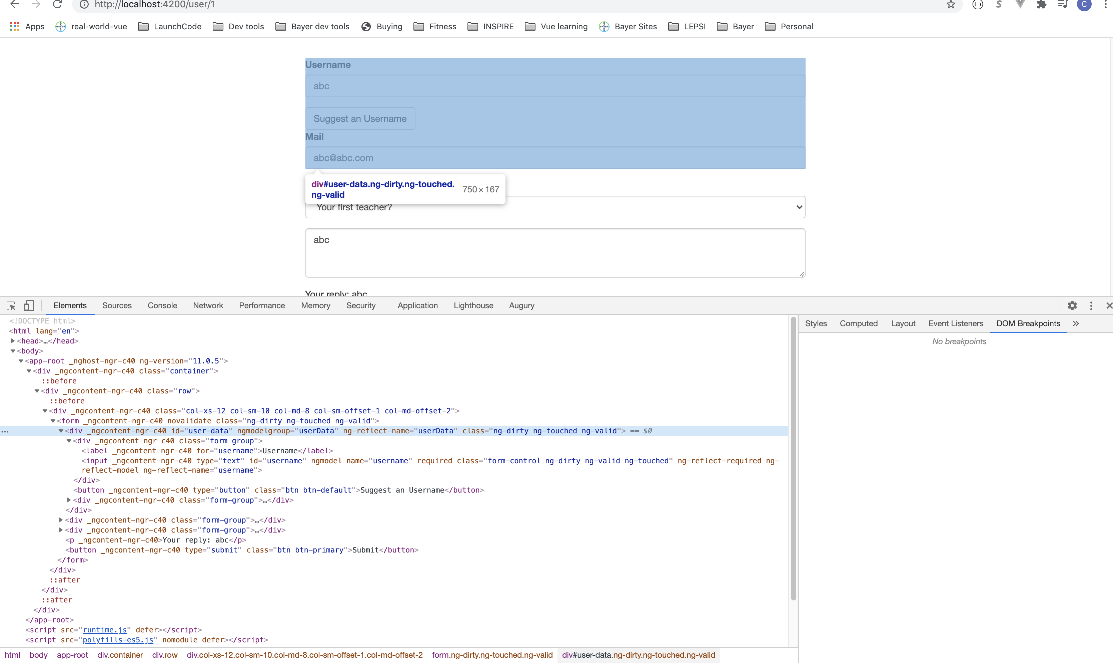
Grouping form controls – structure in object.
Notes:
40

Slide 41
Grouping form controls – structure in object.
You can create a local reference is use it to display validity of form on page.
Notes:
41

Slide 42
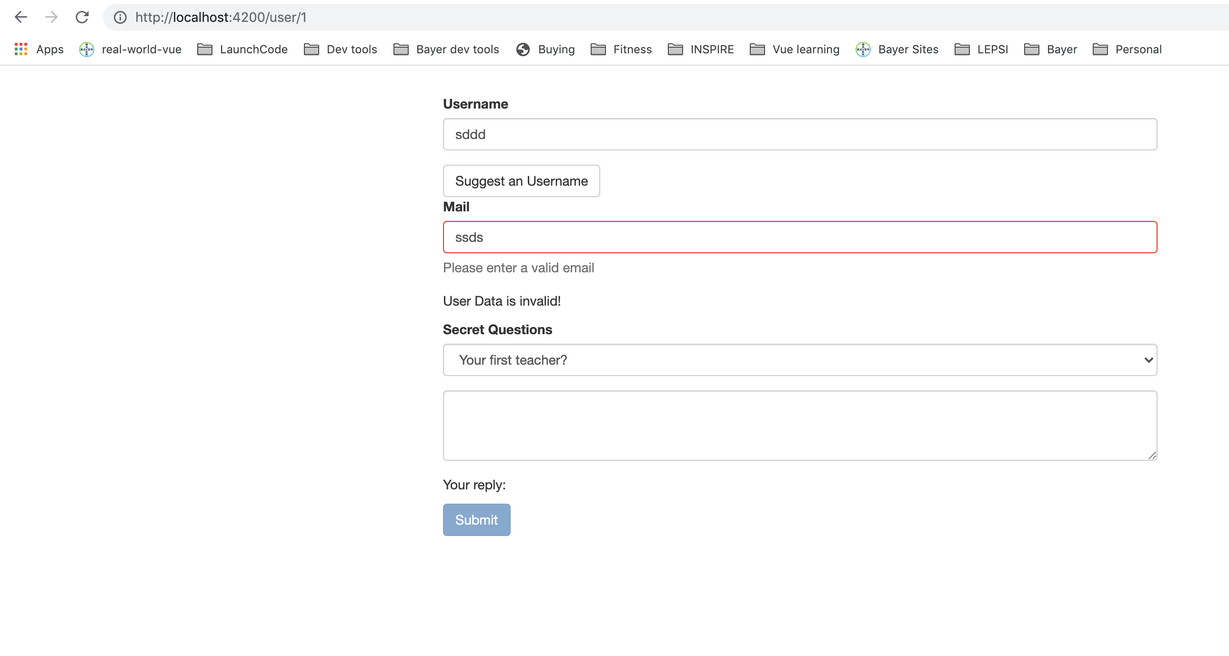
Grouping form controls – structure in object.
Notes:
42

Slide 43
Radio buttons.
Notes:
43

Slide 44
Radio buttons.
Notes:
44

Slide 45
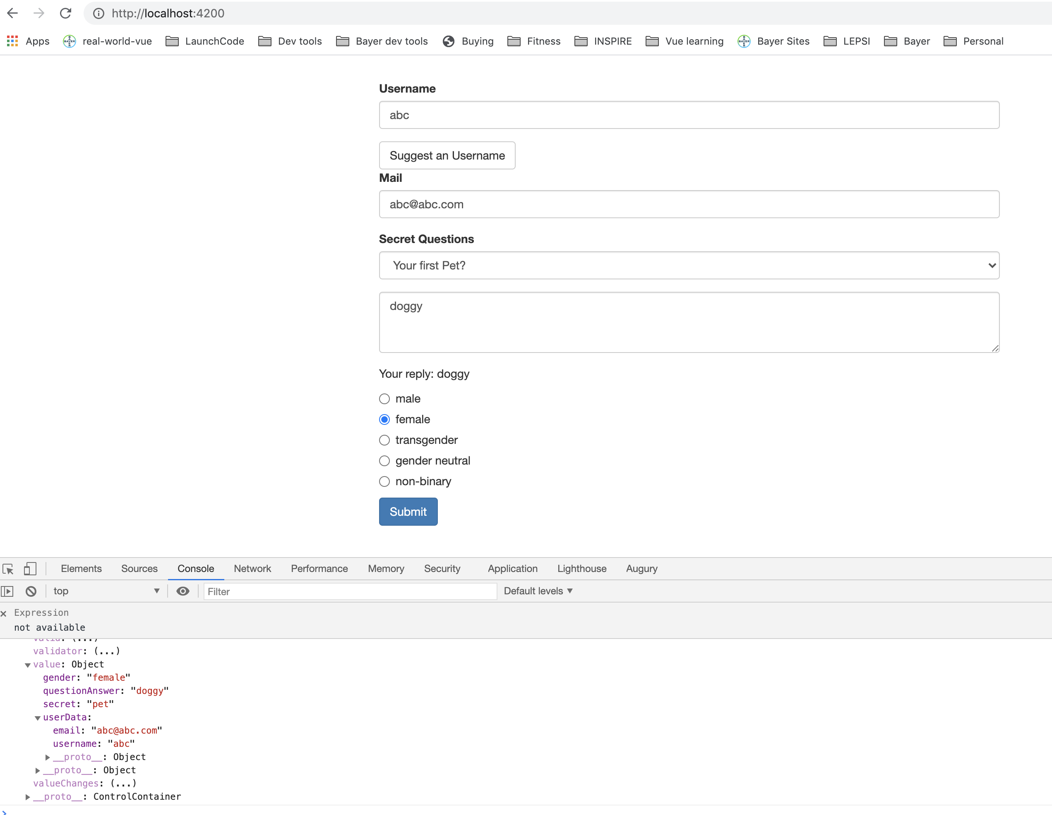
Radio buttons.
Notes:
Can also add required.
45

Slide 46
Setting and patching form values.
Suggest a username button doesn’t work, but we have some method present
Access to form using ViewChild
Notes:
46

Slide 47
Setting and patching form values.
Notes:
47

Slide 48
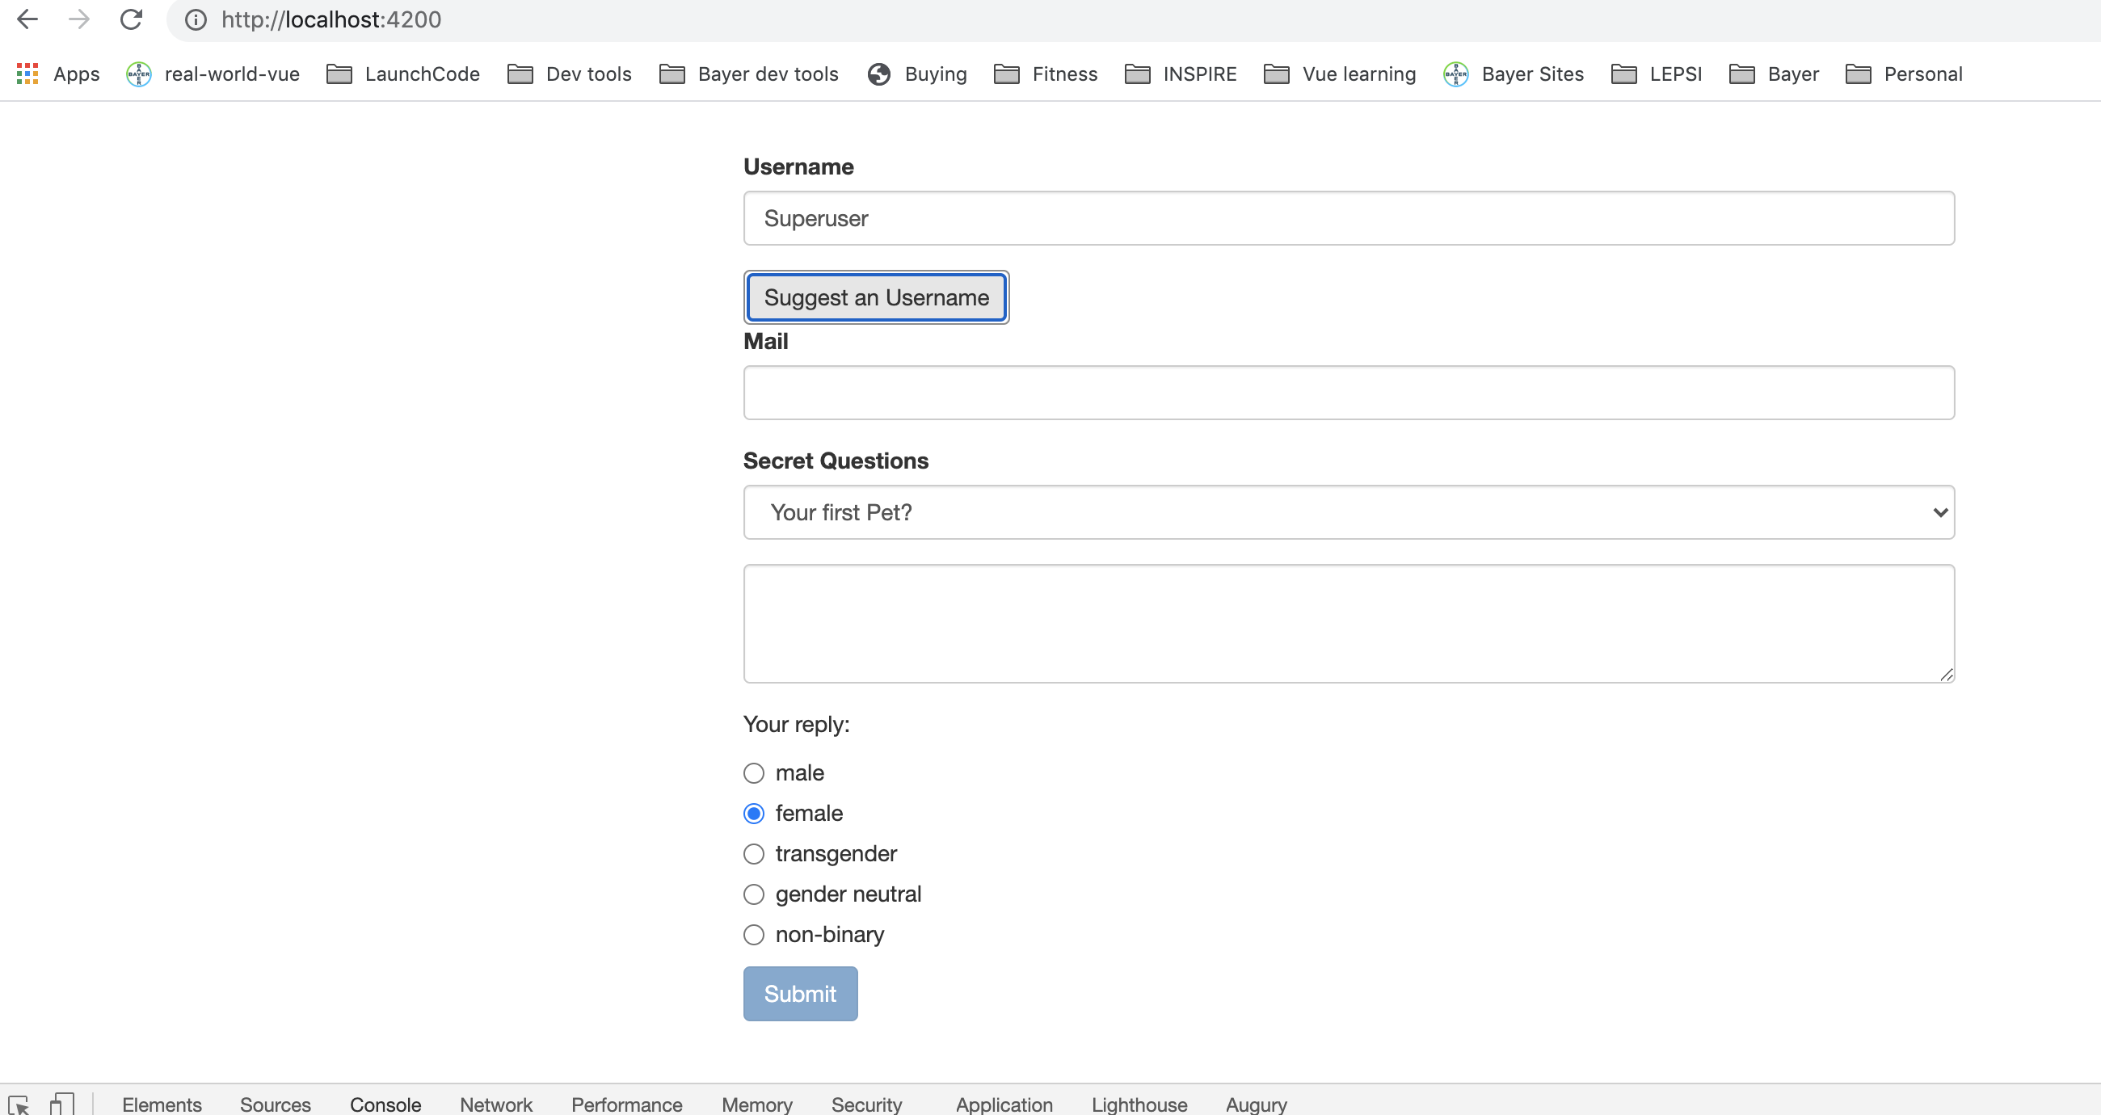
Setting and patching form values.
Notes:
48

Slide 49
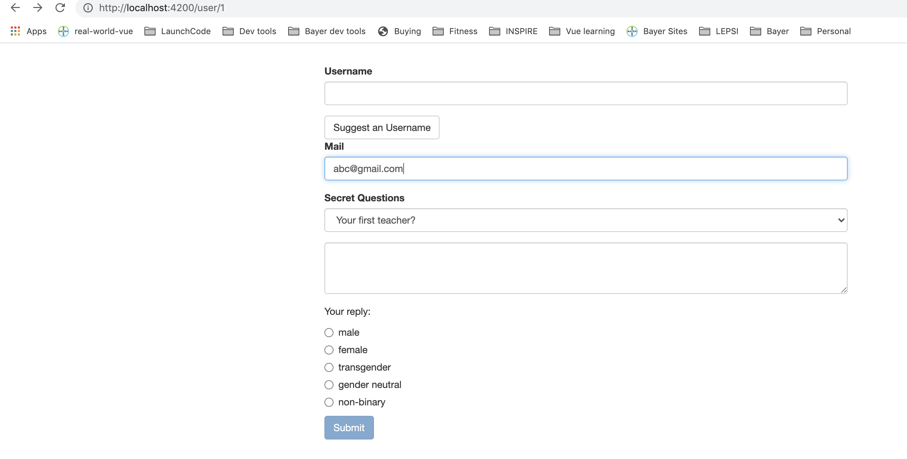
Setting and patching form values.
Notes:
49

Slide 50
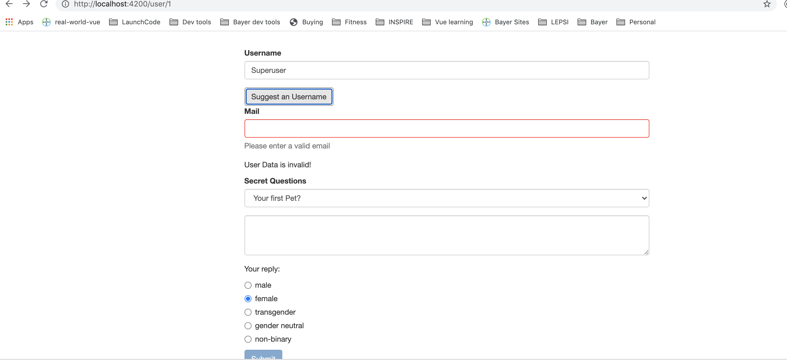
Setting and patching form values.
Notes:
50

Slide 51
Setting and patching form values.
Notes:
51

Slide 52
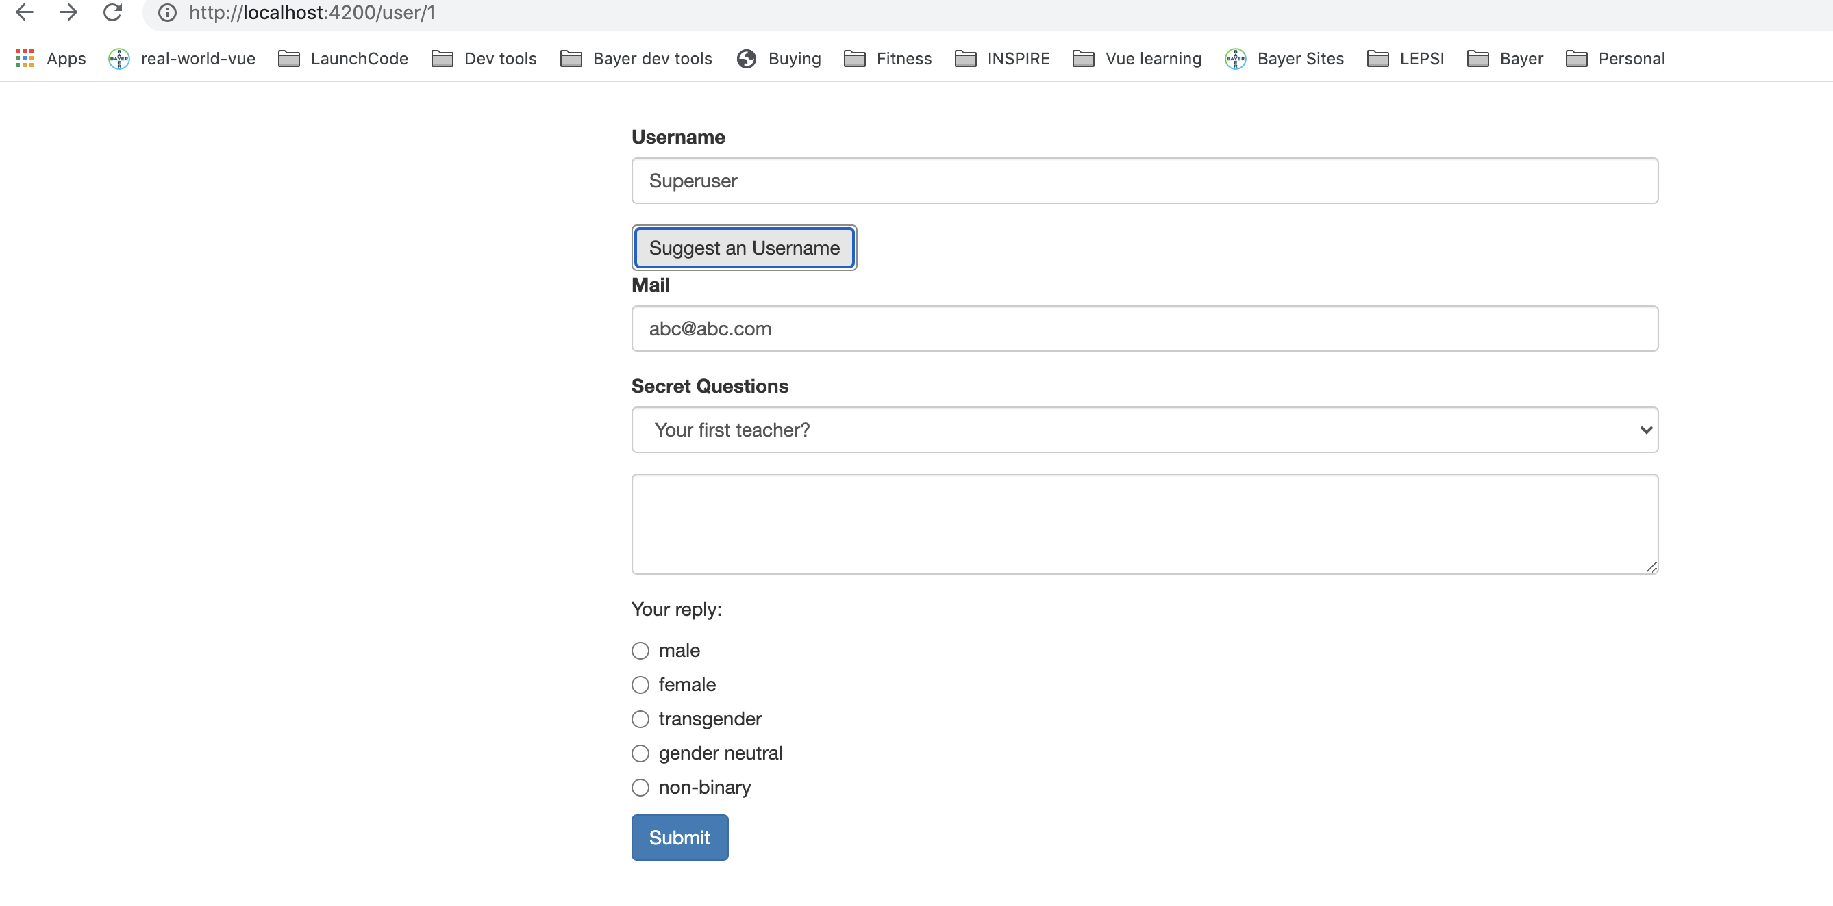
Setting and patching form values.
Notes:
52

Slide 53
Using Form Data.
Let’s summarize the submitted data.
Notes:
53

Slide 54
Using Form Data.
Notes:
54

Slide 55
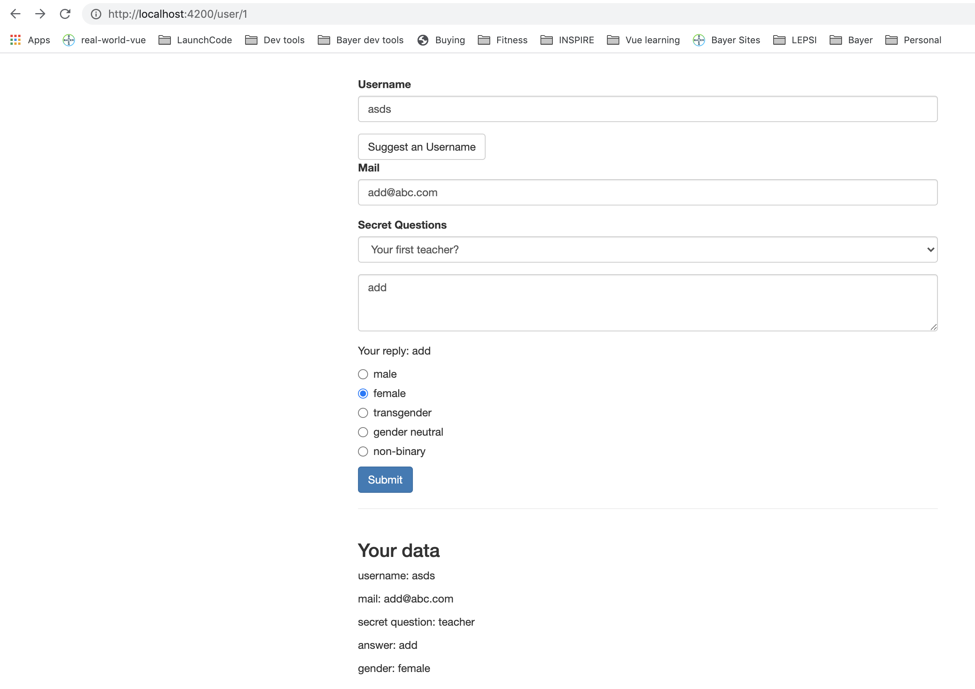
Using Form Data.
Let’s summarize the submitted data.
Notes:
55

Slide 56
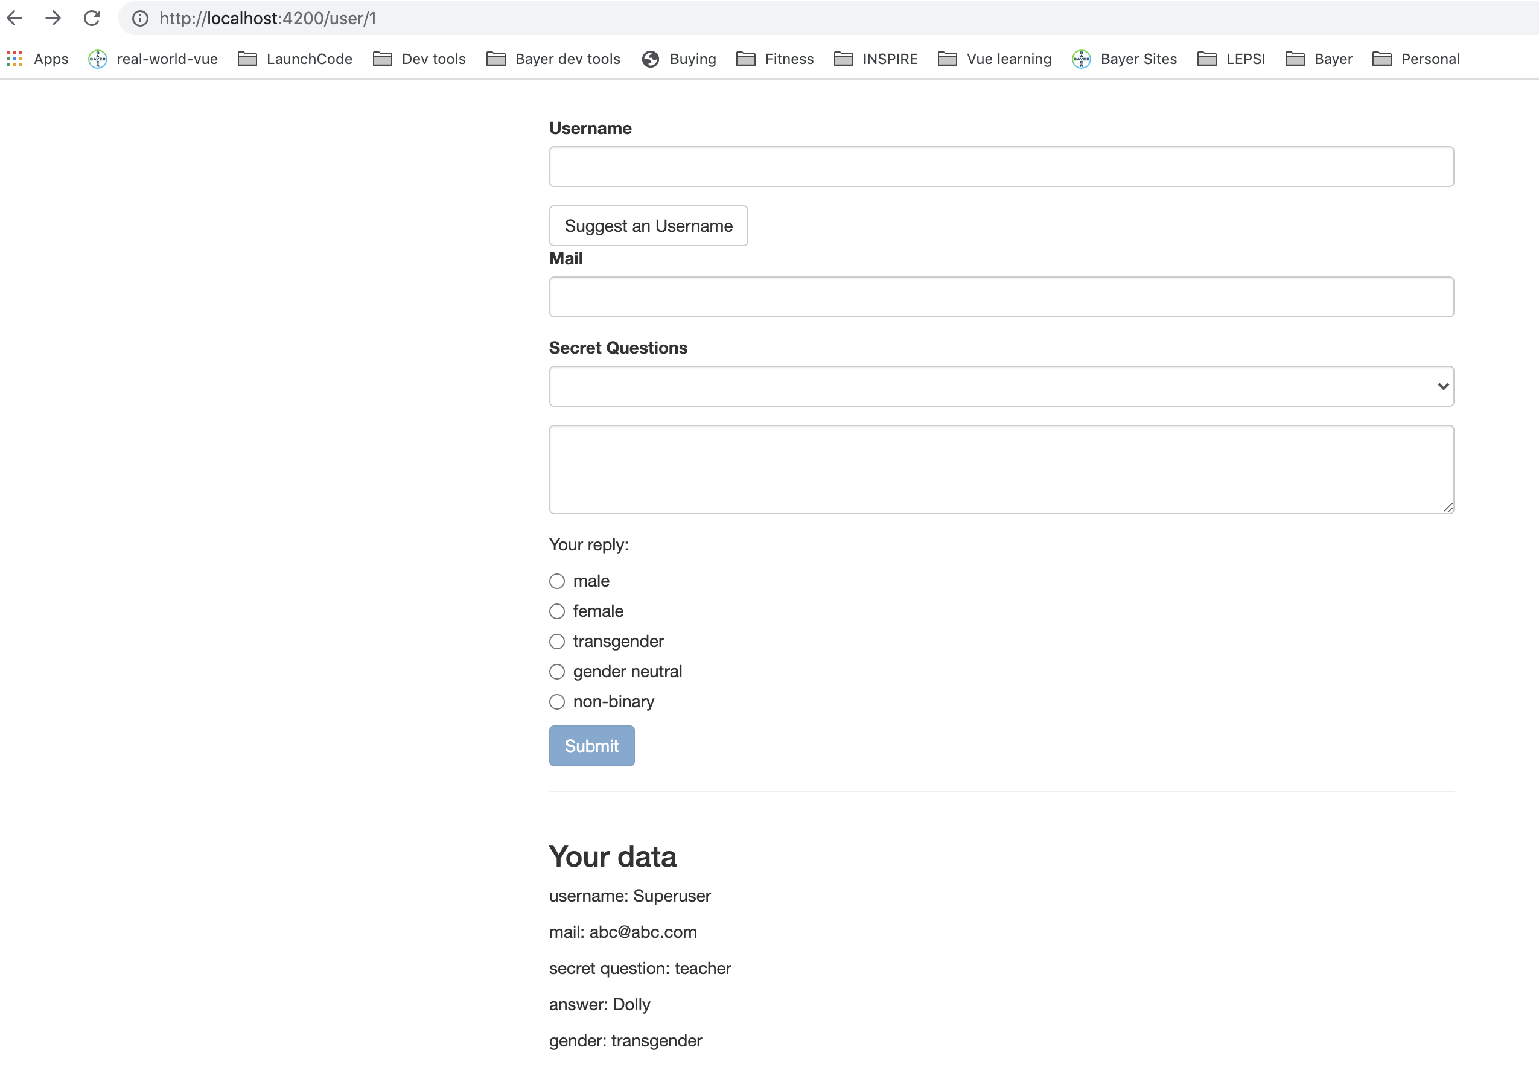
Resetting Form Data.
Extracted data and want to reset the form. It’s simple.
On the form, we can call reset to reset the values and also detach the properties.
this.signupForm.reset();
Notes:
56

Slide 57
Questions?

Slide 58
Studio
Assignment # 6
https://www.udemy.com/course/the-complete-guide-to-angular-2/learn/practice/276#overview

